Slide 1
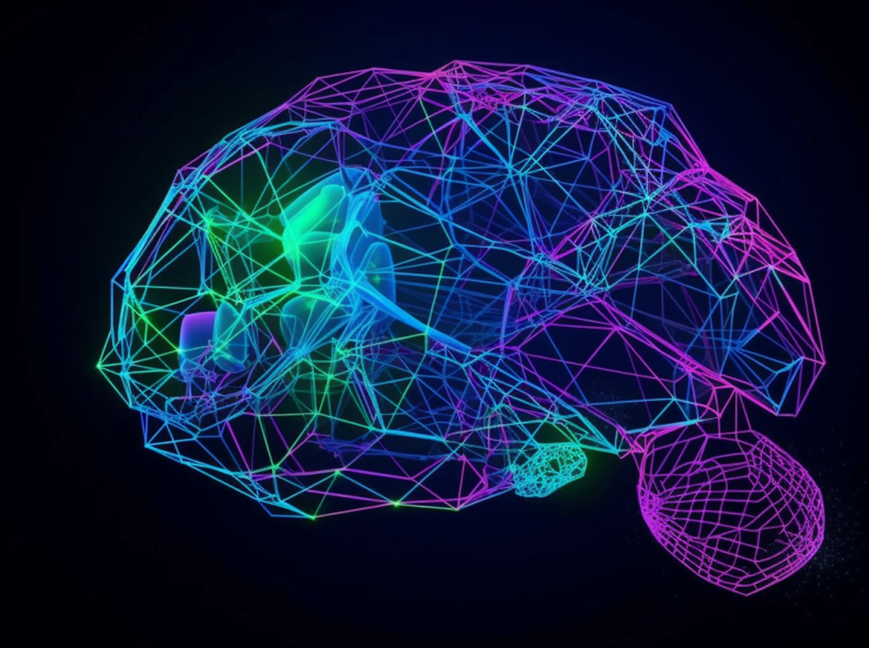
TVM Quantization Experiments
With ResNet50 Machine Learning Model

Slide 2

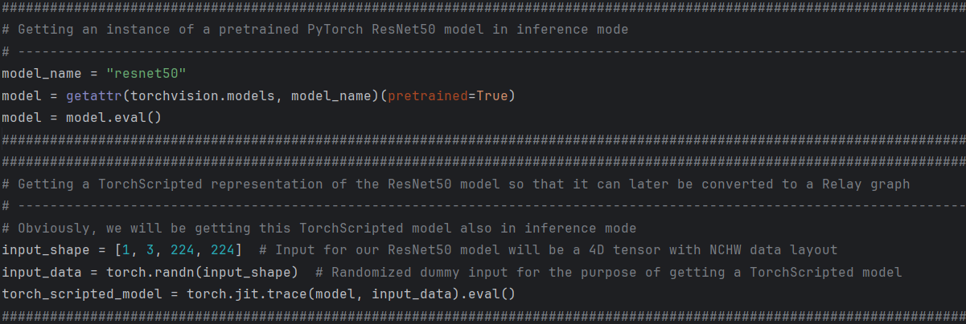
Question 1: Get an instance of a ResNet50 model implemented in PyTorch. It's available in the torchvision package.
Answer 1:

Slide 3
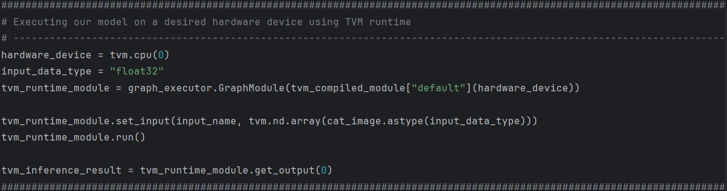
Question 2: It's a good idea to try TVM on an un-quantized DNN first. Give TVM the network and a sample input to the network, and compile the network into a function object that can be called from Python side to produce DNN outputs. The TVM how-to guides has complete tutorials on how to do this step. Pay attention to the compilation target: which hardware (CPU? GPU?) the model is being compiled for, and understand how to specify it. Compile for GPU, if you have one, or CPU otherwise.
Answer 2: tvm_runtime_module.run() can be called from Python side to produce DNN outputs. Hardware device (CPU) is specified when creating tvm_runtime_module based on tvm_compiled_module.

Slide 4
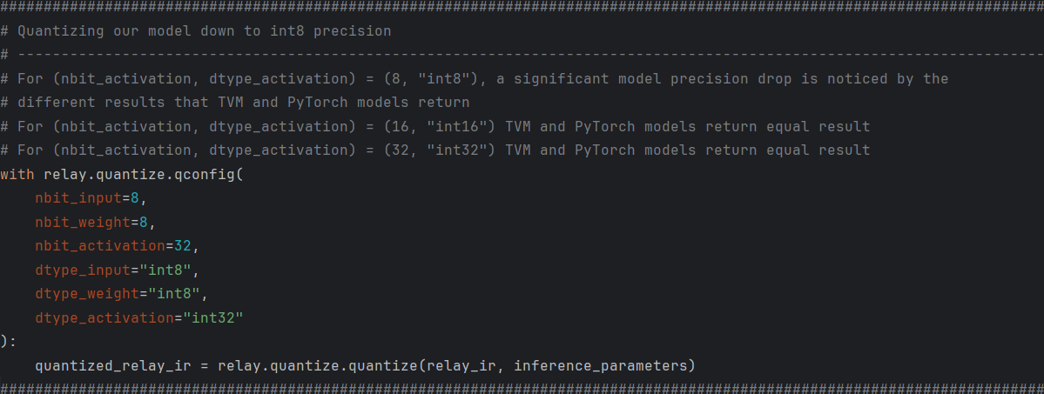
Question 3: Now, quantize the model down to int8 precision. TVM itself has utilities to quantize a DNN before compilation; you can find how-tos in the guides and forum. Again, you should get a function object that can be called from Python side. Hint: there is a namespace tvm.relay.quantize and everything you need is somewhere in there.
Answer 3: quantized_relay_ir is later used for the TVM compilation of the model.

Slide 5
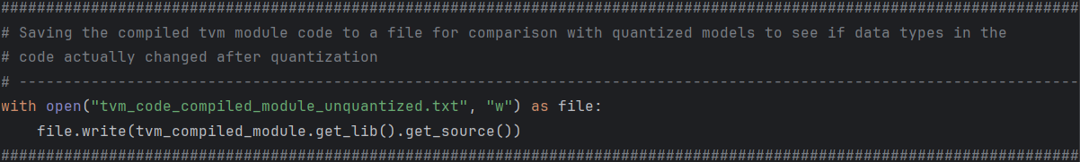
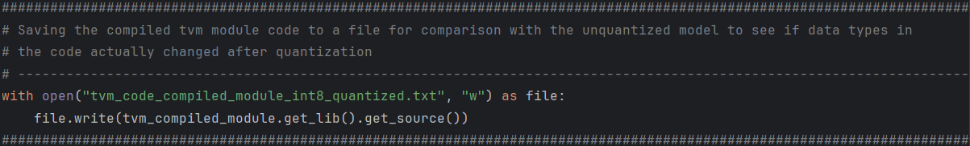
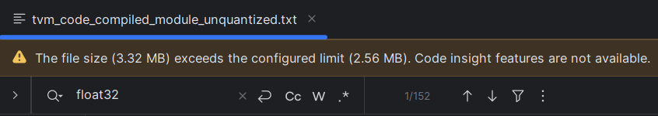
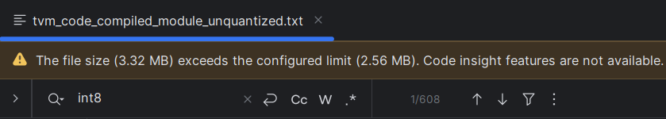
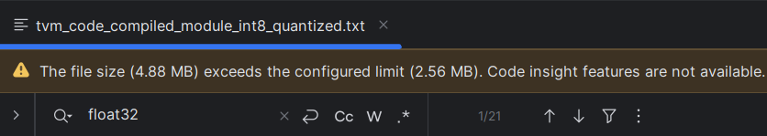
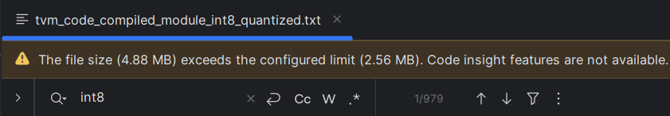
Question 4: Just for your own check - how can you see the TVM code in the compiled module? Did the quantization actually happen, for example, did the data types in the code change?
Answer 4: By comparing LLVM IR codes generated by compiling unquantized and quantized models, it is obvious that the number of float32 data types has drastically decreased while the number of int8 data types has increased after quantization, so that proves that the model was quantized successfully.

Slide 6
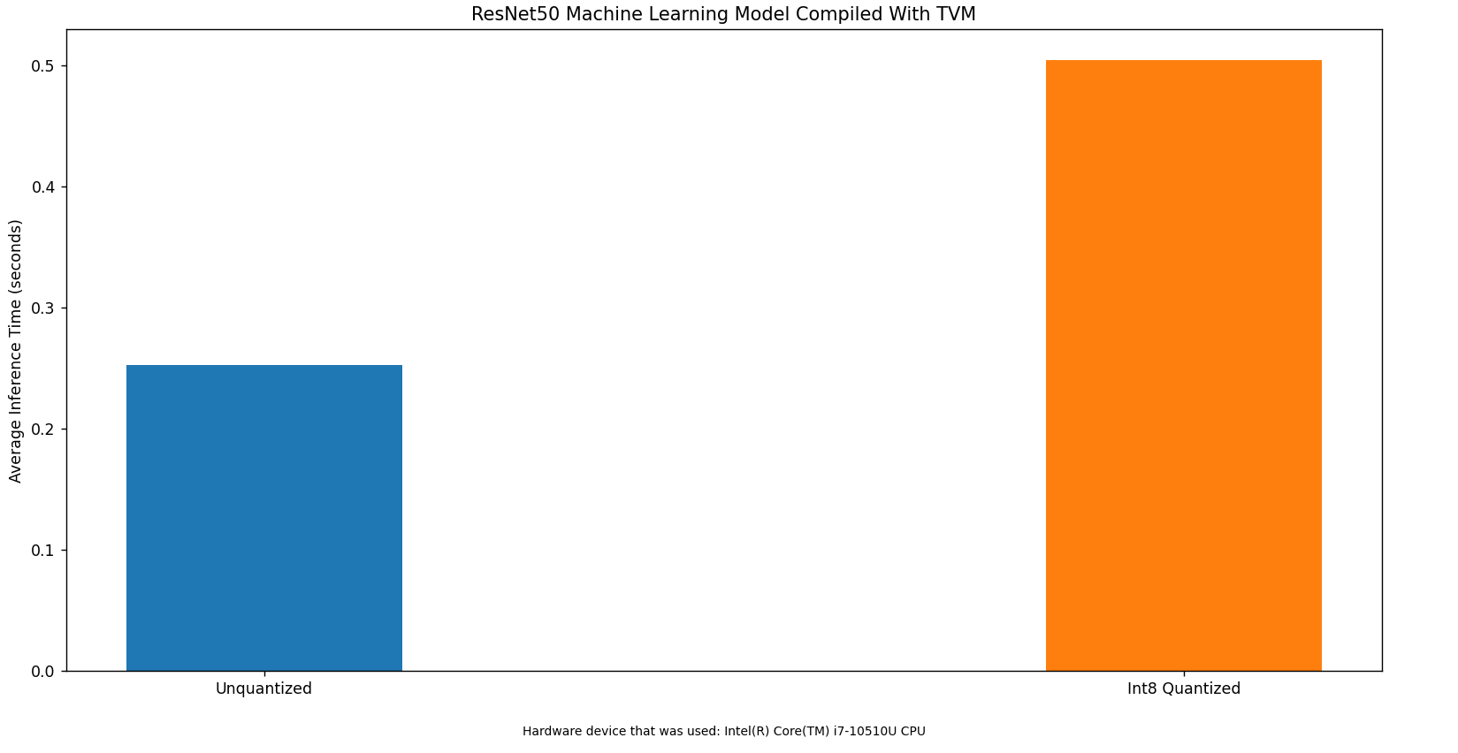
Question 5.1: Use TVM's utility functions to benchmark the inference time of the quantized model vs. the un-quantized model.
Answer 5.1.1: Both models were executed with 20 randomized dummy inputs (30 times per input). These are average inference times of all executions for both models.

Slide 7
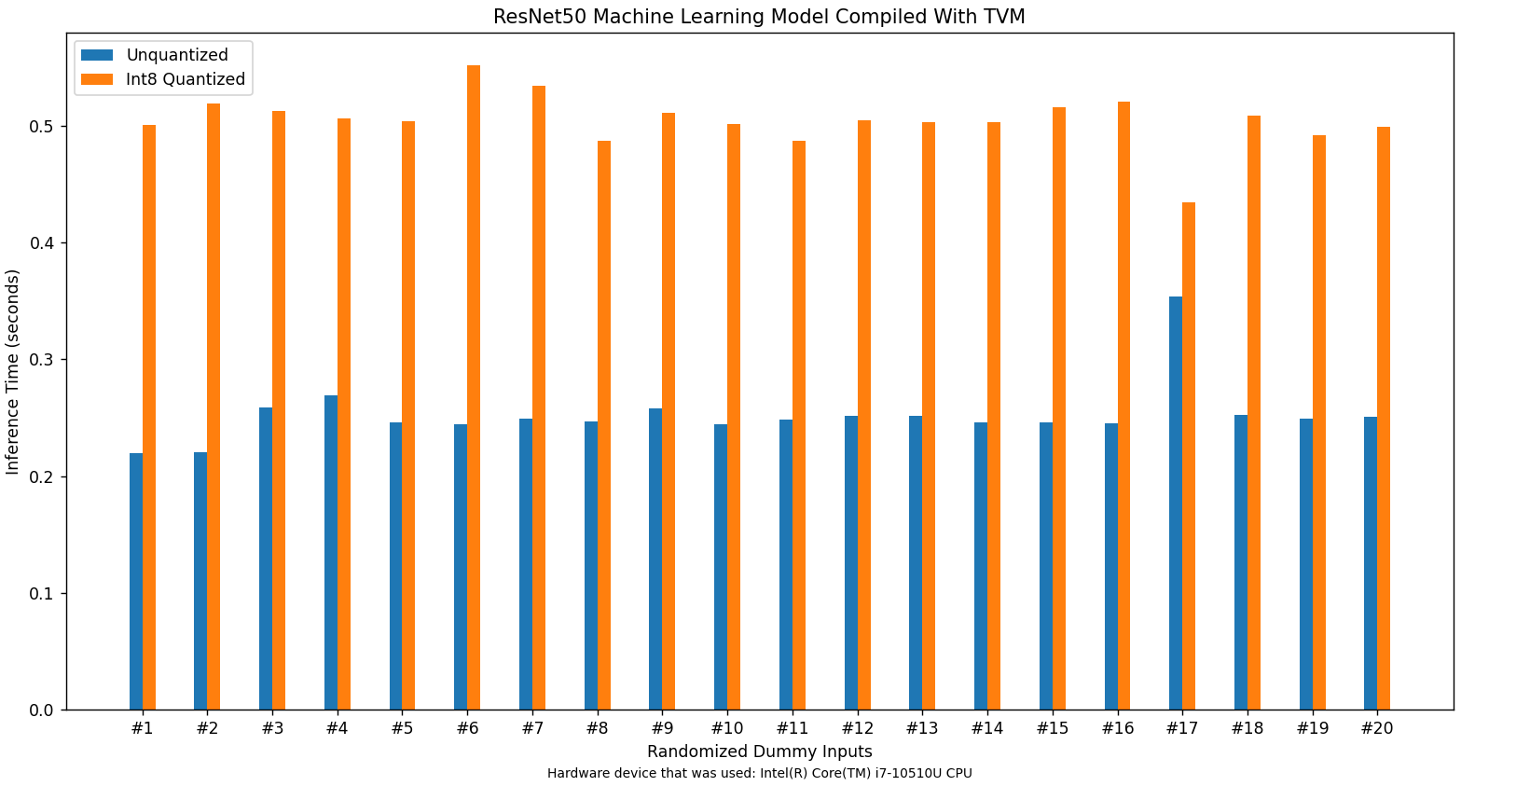
Answer 5.1.2:

Slide 8
Question 5.2: In this task we will not try to maximize the performance of the quantized DNN, but if there is no speedup, you should try to understand it and formulate a guess. Hint: TVM may print the following when you compile the DNN: “One or more operators have not been tuned. Please tune your model for better performance. Use DEBUG logging level to see more details”. What does it mean?
Answer 5.2: The message printed by TVM indicates that there are operators in the ResNet50 neural network that are not optimized for the target hardware. This is expected, since I didn’t explicitly tune the model anywhere in my code. This could be solved by incorporating AutoTVM, a tuning module within TVM that automatically optimizes the operators in the model so that they are more efficient for the target hardware. TVM’s AutoScheduler would also potentially speed up the inference by automatically optimizing the scheduling of operations across the entire neural network. In conclusion, autotuning would definitely improve the performances of both the unquantized and quantized models. However, I assume that the absence of autotuning has a more pronounced impact on the quantized model due to the additional complexities introduced by quantization. I believe that could be the reason why the unquantized model outperforms the int8 quantized model in these experiments.

Slide 9
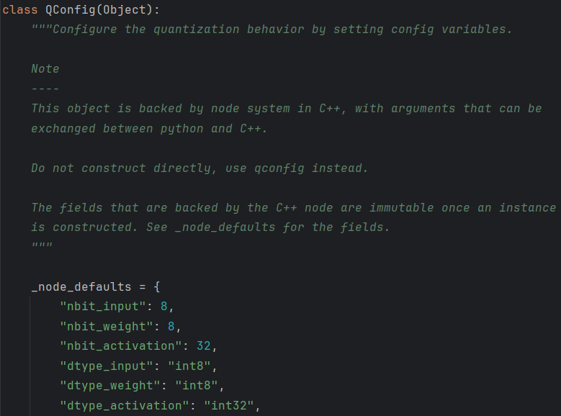
Question 6.1: In your quantization setup, how did TVM know that you wanted to quantize to int8? Look into that, and vary the number of bits of quantization (the n in int-$n$). Searching in forum and peeking the source code of the quantizer class will both help.
Answer 6.1: TVM knew that I wanted to quantize to int8 because I had explicitly set that using tvm.relay.quantize.qconfig as I have shown previously in my answer to question number 3. However, even if I hadn’t explicitly set that, TVM would have done the quantization to int8 because that is the default quantization configuration as can be seen in the QConfig class that I have found in the tvm/python/tvm/relay/quantize/quantize.py file.

Slide 10
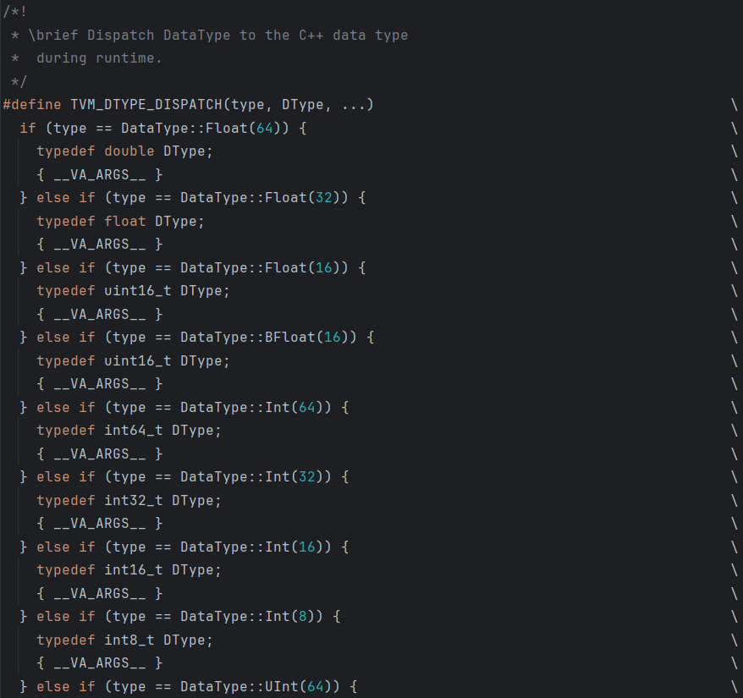
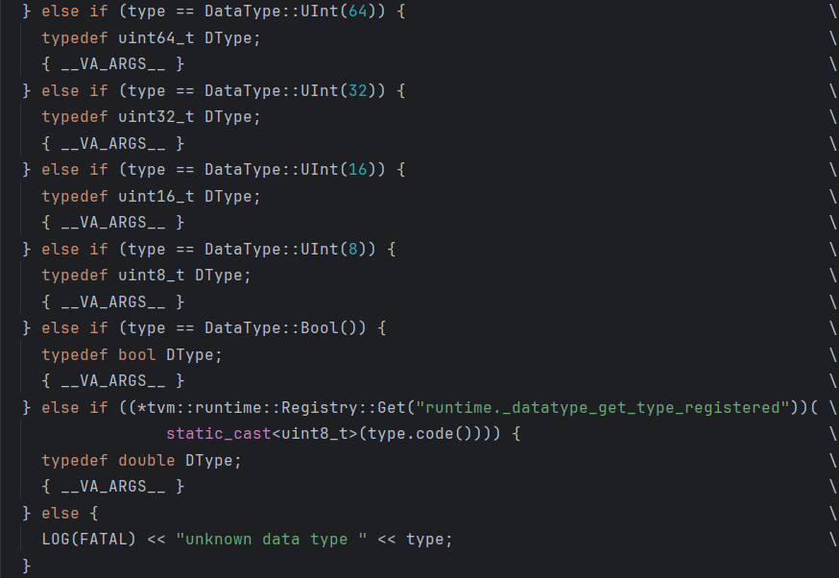
Question 6.2: Try out int8 -> int4 -> int2 -> int1; note which precisions work. When it doesn't work, note exactly which part is failing.
Answer 6.2: The program works fine with int8 and int1 (bool) quantizations, but it crashes with int4 and int2 quantizations. TVM prints an error saying that those data types are unknown. I believe that is the case because TVM has no direct support for those data types. To prove that, I have found a C++ macro in the tvm/src/relay/transforms/pattern_utils.h file that obviously contains all the data types that TVM supports – int4 and int2 data types are not among them. Also, the unknown data type error is printed by this macro.

